Slide 1

Vehicle Counting Application using YoloV3 and COCO
Made by : Jai Anand
2016792
Guided By : Dr Vikas Tripathi
Associate Professor, Dean(R&D), GEU Dehradun

Slide 2

Tools Used
COCO Dataset
Common Objects in Context Common Objects is a database that aims to enable future research for object detection, instance segmentation, image captioning, and person key points localization. COCO is a large-scale object detection, segmentation, and captioning dataset.
Processing Tools
SciPy is a free and open-source Python library used for scientific computing and technical computing.
NumPy is a library for the Python programming language, adding support for large, multi-dimensional arrays and matrices.
OpenCV-Python
OpenCV is a library of programming functions mainly aimed at real-time computer vision.
IDE and Python Programming Language
VS code is used for the project

Slide 3

YOLO
You Only Look Once.
Developed by Joseph Redmon and Ali Farhadi in 2015 and subsequent versions, including YOLOv2 and YOLOv3 and later.
SOTA(State of the Art Technique)
→ advanced level of performance that has been achieved in a particular field or area of study. It means that the model has achieved the highest level of accuracy and speed among all object detection models that are currently available.

Slide 4
YOLO vs Faster RCNN
In addition to increased accuracy in predictions and a better Intersection over Union in bounding boxes (compared to real-time object detectors), YOLO has the inherent advantage of speed.
YOLO is a much faster algorithm than its counterparts, running at as high as 45 FPS.
While algorithms like Faster RCNN work by detecting possible regions of interest using the Region Proposal Network and then perform recognition on those regions separately, YOLO performs all its predictions with the help of a single fully connected layer.
Methods that use Region Proposal Networks thus end up performing multiple iterations for the same image, while YOLO gets away with a single iteration.

Slide 5
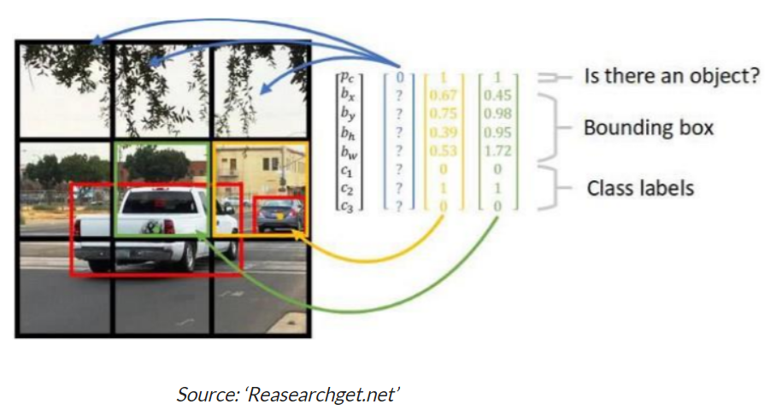
YOLOv3 Working
Detection systems use localizers or classifiers to carry out the detection process. Then the model is applied to an image at different scales and locations. The regions of the image with high scoring are considered for detections.
Yolo uses different approach. The algorithm applies a single neural network to the entire full image.
Then this network divides that image into regions which provides the bounding boxes and predicts probabilities for each region.
These generated bounding boxes are weighted by the predicted probabilities.
The non-max suppression technique makes sure that the object detection algorithm only detects each object once and it discards any false detections.
Pic Credit : researchgate.net

Slide 6
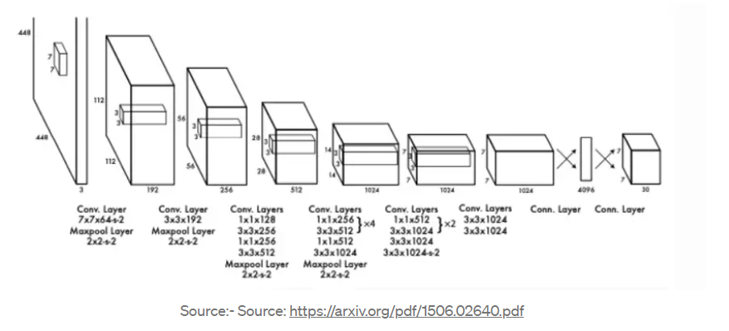
Working Methodology
Step 1: import libraries and set path and virtual environment
Step 2 : load yolov3 model(.Cfg) along with coco. Names and weights.
Step 3: read frames and get the blobs
Step 4: implementing forward pass and get bounding boxes.
Step 6: apply non-maximum suppression (nms.).
Step 7: drawing of bounding boxes, without overlapping
Step 8: count the number of vehicles and increment the counter
Step 9: write into the output file and save it as output. AVI

Slide 7

Result and Inference
We used the 6 features out of the set of 80 features present in the coco dataset which are as follows:
["bicycle", "car", "motorbike", "bus", "truck", "train"]
The performance of a vehicle counting application using YOLO will depend on several factors, including the quality of the training dataset, the complexity of the model, and the conditions of the video stream.
Since we have used the coco dataset the accuracy of our model is very high and is able to determine and count nearly all the vehicles in the frame

Slide 8
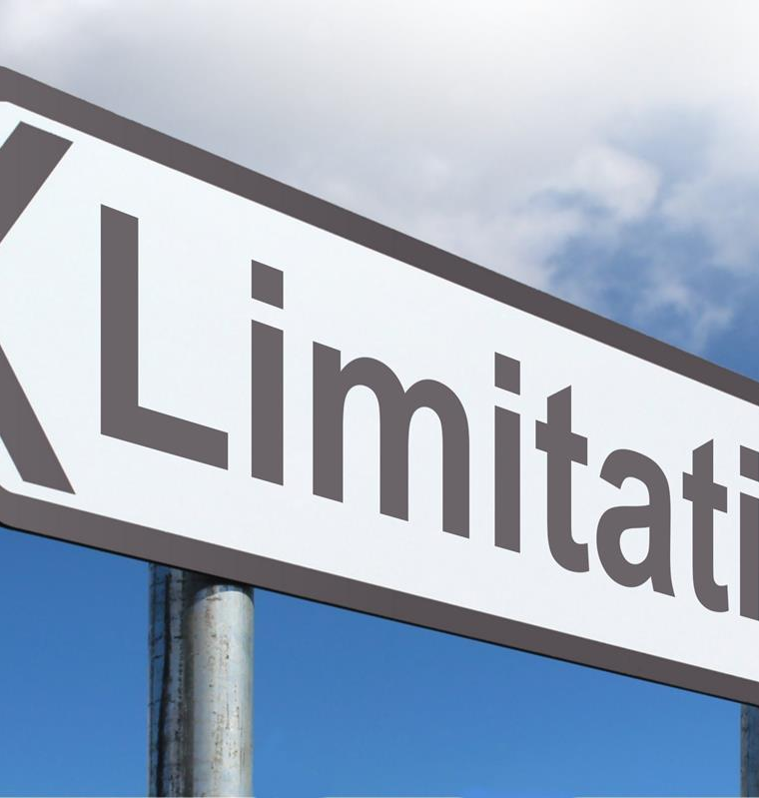
Limitations and Future Work
Implementation of the vehicle counting application on our personal machine where GPU was unavailable. “setup Net module was not built with CUDA backend ; switching to CPU”
YOLO struggles to detect and segregate small objects in images that appear in groups, as each grid is constrained to detect only a single object.
YOLO is also characterized by lower accuracy when compared to much slower object detection algorithms like Fast RCNN.

Slide 9
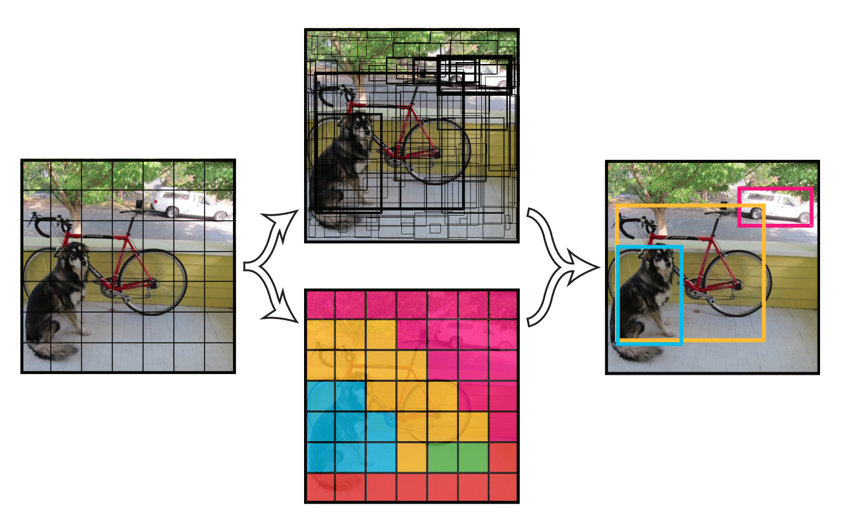
Applications
Incorporating additional features: The model could be enhanced by incorporating additional features, such as vehicle speed or direction, which could be useful for traffic analysis.
Integrating with other systems: The vehicle counting application could be integrated with other transportation and traffic management systems, such as traffic lights or toll booths.
Integrating with private corporations: The Application can be extended to implement a full-fledged automatic parking receipt system by usage of vehicle number plate registrations.

Slide 10
Thank You

